Slide 1
Does the Nucleus Accumbens mediate Aversive Behavior?
Clarissa Staton

Slide 2
Why do we care?
Mesolimbic dopaminergic system=important for motivation, learning & disorders
Knowing about how the mesolimbic system connects & functions can better the behaviors effected by this system
Notes:
Mesolimbic dopaminergic system→originates in VTA

Slide 3
The problem…
The circuitry/neurochemical mechanisms remain either unknown or controversial…
We will address some of those issues today to give more insight.

Slide 4
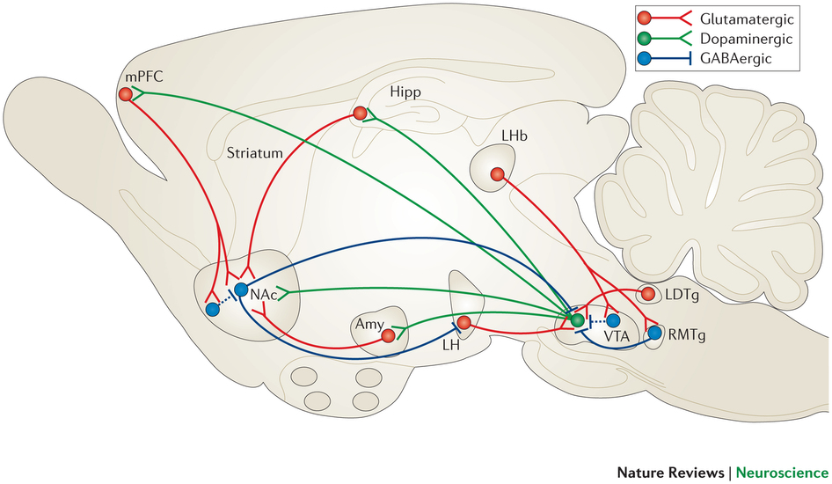
Ventral Tegmental Area (VTA)
Tan et al: Introduction
Said to drive reward-related behavior
Has projections to many areas→ including NAc
Composed of..
~65% DA neurons
~30% GABA neurons
~5% glutamatergic neurons

Slide 5
(VTA) DA Neurons
Tan et al: Introduction
Fire in anticipation of error or reward
Inhibited by absence of reward
Can manipulate firing via aversive stimuli
Aversive=a reprimand, punishment, or agent, used in aversive conditioning

Slide 6
(VTA) DA Neurons cont’d
Tan et al: Introduction
Can inhibit DA neurons by using aversive stimulus that excites the GABA neurons 1st
Notes:
This was shown earlier in the article with the results.

Slide 7
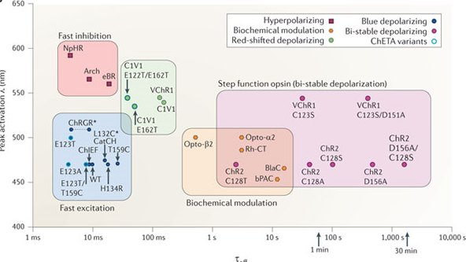
Optogenetic Activation
Tan et al: Methods
ChR2-eYFP into GABA neurons of VTA
Transcribed only in neurons with Cre

Slide 8
Place Aversion Test “Aversive Conditioning ”
Tan et al: Methods
GADcre+ & GADcre- mice
4 days
Stimulation Chamber
Notes:
Positivie means the mice had the excitatory GABA
1 day pretest→2 days conditioning→ 1 day posttest

Slide 9
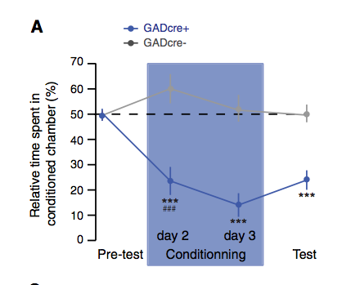
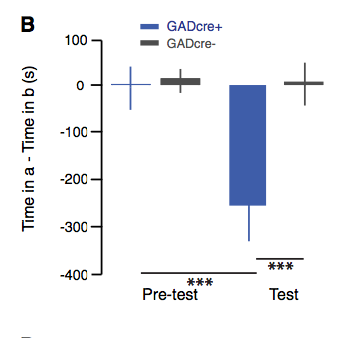
Optogenetic activation of VTA GABA neurons is sufficient to drive conditioned place aversion
Tan et al: Results
Remember: activating GABA→ inhibits DA
Notes:
Remember: activating GABA→ inhibits DA
** leads to conditioned place aversion

Slide 10
So what is aversive behavior?
Tan et al: Conclusions
Aversive behavior: movement of an organism away from a certain type of stimulus, such as electric shock.

Slide 11
What does this tell us?
Tan et al: Conclusions
Exciting GABA neurons in VTA→ inhibition of DA neurons in VTA→ aversive behavior
But… is this aversive behavior due to the VTA inhibition of DA? Or a down-regulatory effect??

Slide 12
Subjects & Optogenetic Inactivation
Danjo et al: Materials & Methods
Adult TH-Cre mice (18) & WT mice
Injected with construct encoding Arch-eGFP

Slide 13
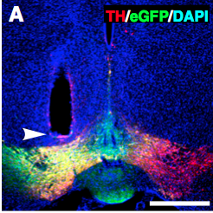
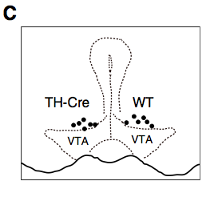
Subjects & Optogenetic Inactivation cont’d
Danjo et al: Materials & Methods
Injected unilaterally into the VTA
Optical Fiber placed above VTA
Notes:
2 weeks later→Arch-eCFP restrictedly detected in the VTA

Slide 14
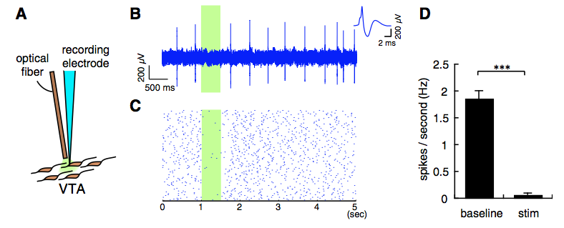
Subjects & Optogenetic Inactivation cont’d
Danjo et al: Materials & Methods
Optical stimulation inhibited firings of DA neurons →hyperpolarized DA cells→ inhibited spontaneous firing
Notes:
In vivo electrophysiological recording for the inactivation of Arch-expressing DA neurons by optical stimulation. (A) Scheme for in vivo recording from DA neurons in the VTA and optical stimulation. (B and C) Single-unit recording (B) and raster plot (C) of an Arch-eGFP–expressing DA neuron. Firings were inhibited by optical stimulation (green rectangles). An averaged spike waveform of a typical DA neuron is shown in the Inset. (D) Firing rates of Arch-eGFP– expressing DA neurons. During optical stimulation, the firing rate was decreased to 0.07 ± 0.02 Hz (t12 = 13.55, ***P < 0.0001; paired t test, n = 13).

Slide 15
Behavioral Tests
Danjo et al: Materials & Methods
2 types of behavioral tests performed
1) Dark-Room Preference Test
2) Three-Chamber CPA Test

Slide 16
Behavioral Test #1
Danjo et al: Materials & Methods
Dark-Room Preference Test
Note: No difference in time spent in dark room

Slide 17
Optogenetic Inactivation of DA Neurons Blocks Dark-Room Preference
Danjo et al: Results
Notes:
**Shows that hyperpolarization (inactivation) of DA neurons caused short term aversive behavior
**also showed that hyperpolarization was a signal fore aversive learning → (like a conditioned stimulus) against the dark room
**Also suggest that the inactivation of the DA neurons played a casual role in short and long term aversive learning -→not so sure I agree with these because how did they demonstrate prolonged?

Slide 18
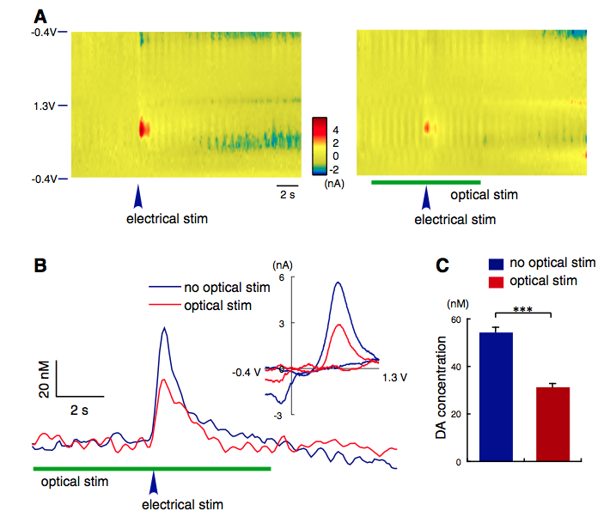
Optogenetic Down-Regulation of DA Levels in the NAc
Danjo et al: Results
Notes:
DA levels evaluated by electrical stimulation of VTA→ also looked @ w/ optical stimulation. Showed that DA release significantly reduced by optical stimulation
Optical inactivation of DA neurons in the VTA suppresses evoked DA response in the NAc. (A) Background-subtracted voltammograms showing DA release in the NAc by electrical stimulation with (Right) and without (Left) optical stimulation of the VTA. The y axis is the applied potential (Eapp versus Ag/AgCl reference electrode); and the x axis, the recording time. Current changes at the electrode are encoded in color. An increase in the DA level was seen during electrical stimulation with the applied potential of ∼0.650 V (oxidation peak encoded as red). (B) Representative voltammetry traces obtained by electrical stimulations with or without optical stimulation. (Inset) Background-subtracted voltammogram taken from the peak of the reaction, indicating that the signal measured was DA on the basis of comparison with that of DA obtained in a solution. (C) Peak levels of DA release evoked by electrical stimulation. Optical stimulation of Arch-expressing DA neurons resulted in reduced peak DA levels evoked by electrical stimulation (t12 = 9.434, ***P < 0.001; t test, n = 7).

Slide 19
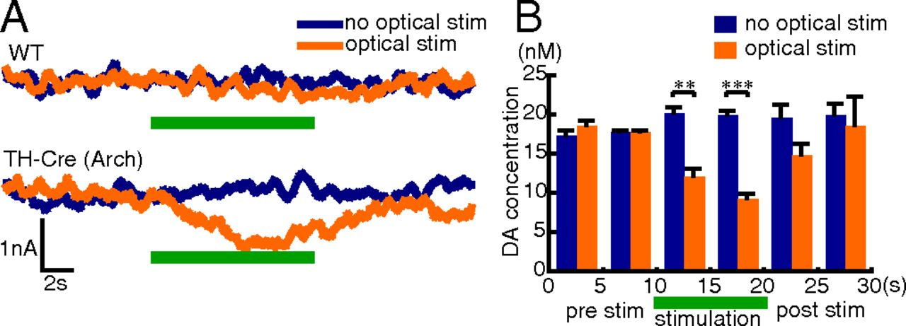
Optogenetic Down-Regulation of DA Levels in the NAc
Danjo et al: Results
Notes:
Tonic… last one just burst with electrical stimulation**data indicated that the optical stimulation of VTA→ effective enough to inactivate the DA neurons in the VTA & diminish DA levels in the Nac during the dark room preference test
→I believe this means that obviously the DA levels→ and therefore the NAc→ place a role in aversive behavior

Slide 20
Up-Regulation of Fos Gene Expression by Optical Inactivation of DA Neurons in the VTA
Danjo et al: Results
Fos gene=immediate early gene for DA neurons

Slide 21
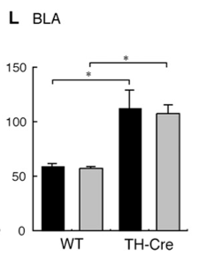
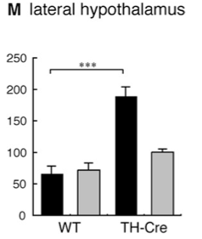
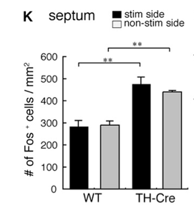
Up-Regulation of Fos Gene Expression by Optical Inactivation of DA Neurons in the VTA
Danjo et al: Results
Notes:
**indicates that the regions activated by optical inactivation not restricted to the direct target areas of the VTA DA neurons →also include regions that could be activated indirectly by neural circuitry.
**suggest that since is a circiry thing.. Could evoke other brain functions like anxiety, fear, stress-responses.

Slide 22
So… now what?
Wanted to look at if aversive conditioning through
Direct pathway (D1)
Indirect pathway (D2)

Slide 23
Indirect vs. Direct pathway
Hikida et al: Introduction
Direct Pathway (striatonigral neurons)
D1R
low affinity
Phasic firing
Indirect Pathway (striatopallidal neurons)
D2R
High affinity
Tonic firing
Suppressed by aversive stimuli

Slide 24
Pathways modulated
Hikida et al: Methods
D-RNB
Direct pathway influenced
I-RNB
Indirect pathway influenced

Slide 25
Conditioned Place Preference (Retention of Aversive Memory)
Hikida et al: Methods
2 days
Electric shocks in dark chamber
Tested 24 hours later

Slide 26
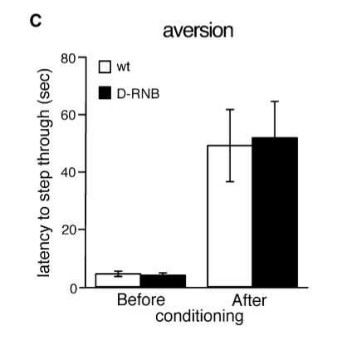
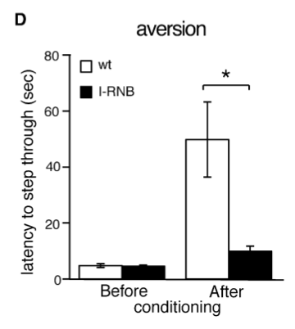
Aversive Memory significantly higher in I-RNB mice
Hikida et al: Results
Notes:
Measured the latency for the animals to enter the dark chamber 24 hours after bing shocked…

Slide 27
What does this mean?
Hikida et al: Conclusions
The indirect pathway is crucial for evoking aversive behavior.
Is this true for the NAc?

Slide 28
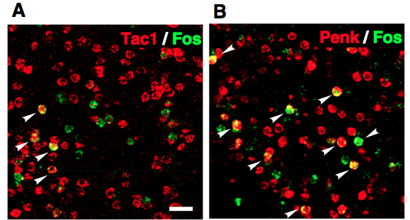
DA Signaling Through D2R is Critical for Optogenetically Induced Conditioned Place Aversion
Danjo et al: Results
D1R
D2R
Notes:
Fos activation observed more in the Penk espressing cells→ which lead lead to the hypothesis that DA signaling through D2 could play role in aversive conditioning

Slide 29
Behavioral Test #2
Danjo et al: Materials & Methods
Three-Chamber CPA Test
Stimulation Chamber

Slide 30
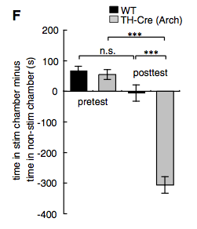
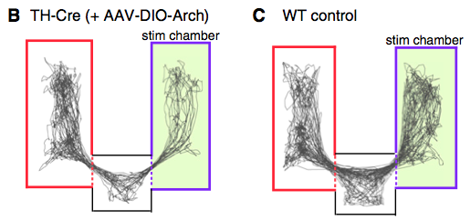
DA Signaling Through D2R is Critical for Optogenetically Induced Conditioned Place Aversion
Danjo et al: Results
Notes:
***B & C (shows posttest)→ TH-Cre avoided staying in the optical stimulation chamber→ Because DA neurons inactivated?
**F→ Sig difference between TH between pretest & pos→ no sig in WT

Slide 31
DA Signaling Through D2R is Critical for Optogenetically Induced Conditioned Place Aversion
Danjo et al: Results
Notes:
**to specify wiich DA receptors were causing aversicy behavior in Nac→ specfically surpressed each DA receptor with lentivirus (mCherry) in Nac
**2 weeks later showed that this mCherry was localized to Nac __> C
**C is just showing that the lentirviral vectors that expreshed shRNA specific for D1 & D2 supressed target RNAs & down-regulated the protein products

Slide 32
DA Signaling Through D2R is Critical for Optogenetically Induced Conditioned Place Aversion
Danjo et al: Results
Notes:
**Results indicate that aversive behaviour to the place conditioned by the DA inactivation was specifically evoke through D2R→ not D1R
DA signaling through D2R is critical for optogenetically induced CPA. (D) Time course of time spent in the stimulated chamber relative to that in the nonstimulated chamber in the CPA test. TH-Cre mice injected with shD2R-containing lentivirus showed significantly different behavioral performance (F_{6,66} = 13.96, P < 0.0001, n = 8–9). (E) Time spent in the stimulated chamber was subtracted from that in the nonstimulated chamber. Lenti:mCherry- or Lenti:shD1R-injected TH-Cre mice showed significantly reduced staying in the stimulated chamber at the posttest, whereas Lenti:shD2R-injected TH-Cre mice showed a significant difference in behavior compared with Lenti:mCherry- or Lenti:shD1R-injected TH-Cre mice (F_{5,44} = 39.30, P < 0.0001; post hoc test, ***P < 0.001, n.s., not significant, n = 8–9).

Slide 33
Pulling it all together
Danjo et al: Discussion
Inhibiting DA firings in VTA→ down regulation of DA levels in NAc
Short-term DA inhibition→ passive avoidance behavior directly
D2R-mediated signal processing is important determinant for onset of aversive reaction & learning.

Slide 34
What could this mean in regards to NAc function?
Indirect pathway inhibits competing behaviors→ What does it mean that it is more prevelant in NAc?
Does this give more evidence to the fact that the NAc is a “reward center”?
Does the idea that the DA neurons project to other regions have anything to do with these results?
Notes:
**could other DA neuron projections explain the aversive behavior-→ because of stressful/fearful stimuli→ not because of the reward/punishment?

